Slide 1
What happens if we hook up only two legs of the potentiometer to our microcontroller?
1
2
Wiper contact
`
`
1
2
3
3
Wiper contact

Slide 2
What happens if we hook up only two legs of the potentiometer to our microcontroller?
Leg 1 to Vcc
Leg 2 to the microcontroller’s analog input pin
5V
Microcontroller
1
Input pin
5V
`
`
1
2
3
3
Input pin
Microcontroller

Slide 3
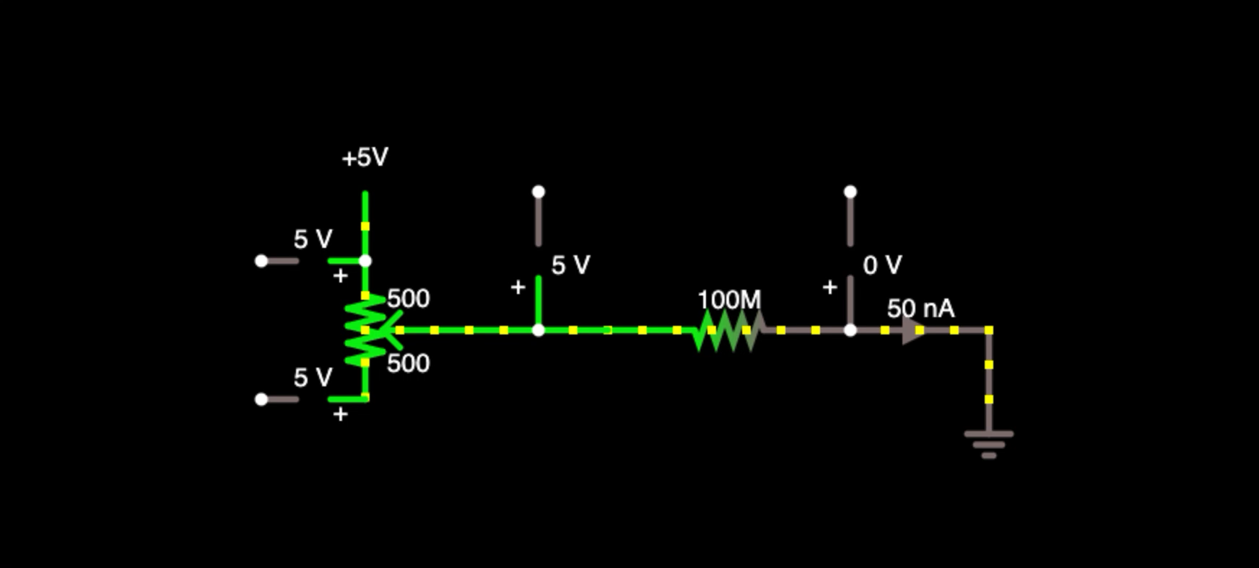
Outside microcontroller
Inside microcontroller
With microcontrollers, virtually no current flows into input pins
No voltage difference across potentiometer. Thus, no current.
Pin A0
No current through potentiometer means that voltage at the input pin (V_{A0}) remains 5V regardless of potentiometer wiper position

Slide 4
Let’s hook up the potentiometer to the microcontroller the correct way.
All three legs should have a connection.
1
2
Wiper contact
`
`
1
2
3
3
Wiper contact

Slide 5
Let’s hook up the potentiometer to the microcontroller the correct way.
All three legs should have a connection.
Leg 1 to Vcc
Leg 2 to the microcontroller’s analog input pin
Leg 3 to GND
5V
Microcontroller
1
Input pin
5V
`
`
1
2
3
3
Input pin
Microcontroller
GND
GND

Slide 6
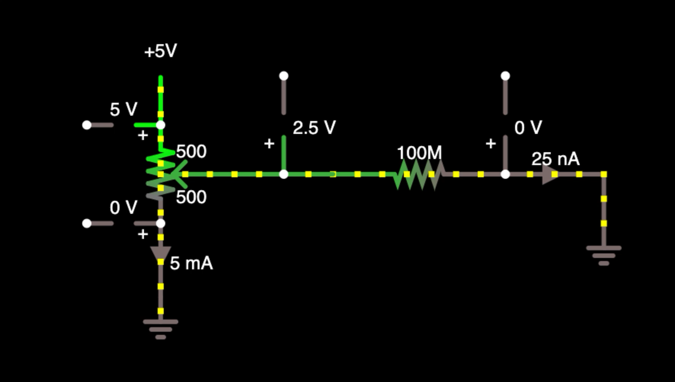
Outside microcontroller
Inside microcontroller
Again, virtually no current flows into MCU input pins
Now, there’s a voltage difference across potentiometer. Current flows!
Pin A0
GND added
(connected to Leg 3 of the potentiometer )
Voltage divider created between R₁ and R₂ in potentiometer. So:
V_{A0}=V_{CC} * R₂ / (R₁ + R₂)

